Slide 1
Mek3700 / Mek4700
Kent-Andre Mardal:
kent-and@math.uio.no
Overview: Project based course
3x projects of length 1 month each
3x project reports combined with oral presentations
Team work
The projects and work are closer to the situation in during a MSc or PhD, or in working life where exact answers are not available and where the terrain is unexplored
The projects involves mathematics and program with application to neuroscience topics
Topics: transport mechanisms
- waste clearance during sleep
- delivery of oxygen
- aggregation of information

Slide 2
Timeline of a project
First week:
Introduction to the topic
Working with exercises related to the topic
Second week:
Presentation of solutions to exercises
Planning of the project, methodology etc
Third week: working with the project
Forth week: presentation, report writing.

Slide 3
Groups for the first project

Slide 4
Waste clearance during sleep (?) Background:
Very basic things are still not known when it comes to the brain´s function. Where are the sewers?
The brain´s weight is 1-2% that of the body, but it receives 20% of the cardiac output – it is hence a demanding organ
It runs on oxygen and glucose
Elsewhere in the body we have a lymphatic system that clears away waste from the extra-cellular matrix
There is no lymphatic system in the brain
Patients with Alzheimer´s and Parkinson´s diseases have accumulations of waste in the brain (Amyloid-beta, CSF-tau).

Slide 5
The greying of Europe
Cost of Alzheimer´s disease in Europe amounts to about 1% of GDP and will increase
The disease develops over decades and early treatment has significant potential
Little effort spent by the computational or biomechanics community compared to sophisticated models that have been developed for cardiovascular diseases
The hallmark feature of the disease is accumulation of metabolic waste (amyloid beta, tau) (as is also common for other types of dementia)

Slide 6
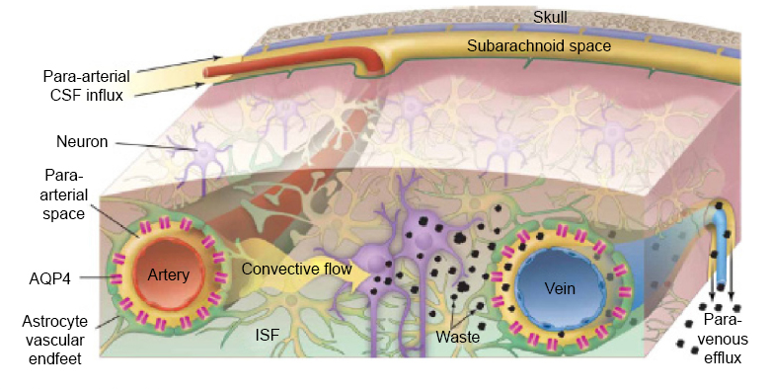
G-lymphatic system: the garbage truck of the brain
The new pathway:
- the paravascular space that surrounds the arteries/arterioles are
connected with the CSF that surrounds the brain. This space facilitate
a bulk flow (viscous flow)
- the hydrostatic pressure gradient between the arterial and venous
sites facilitate a bulk flow through the interstitium (porous flow)
- the waste is then removed on the venous site (viscous flow)
- the G underlines the important role of the glia cells in this system
Nedergaard M. Garbage truck of the brain. Science. 2013

Slide 7
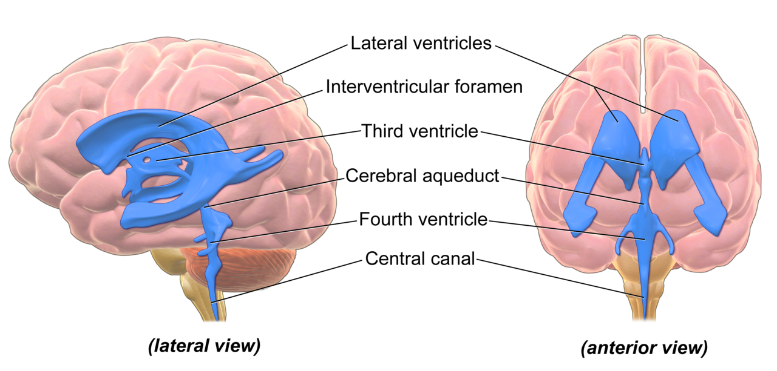
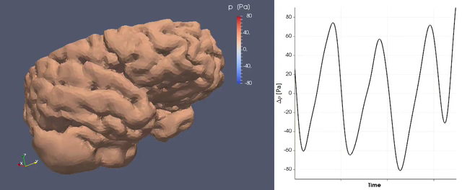
Overview of the poro-elastic brain
Phase contrast MRI
(CSF velocities)
Simulation: Vegard Vinje,
volume changes: A few percent wrt CSF
volume

Slide 8
Why do we sleep?
The 24 hour cycle on earth makes species adapt (eyes important during the day, ears at night)
It is always a demand to reduce the energy costs
It makes sense to relax at night
However, why become “unconscious”?
It is common among all species!
It affects many species, but very clear waves occur in the brain

Slide 9
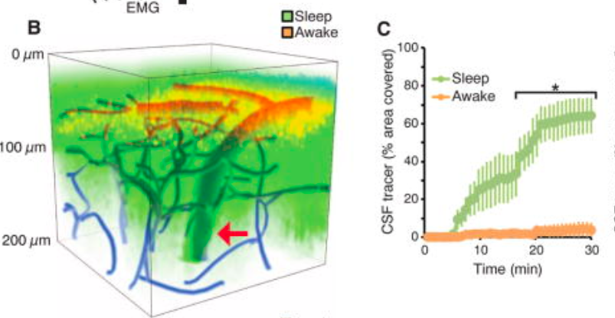
The glymphatic system is hyperactive during sleep because the extracellular volume increases
Xie, Lulu, et al. "Sleep drives metabolite clearance from the adult brain."
Science 2013
3 kDa Texas Red Dextran typically penetrated 100-200 μm in about 20 minutes

Slide 10
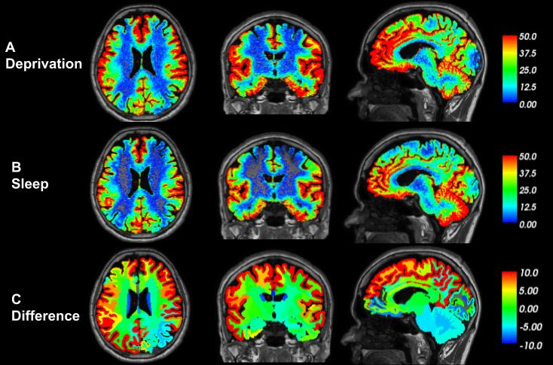
Dementia is associated with sleep disorders and accumulation of toxic metabolic waste -- the effect of sleep on waste clearance from the human brain is not understood
Fluid flow in 24 young (avg. 41 years) patients with
cerebrospinal fluid disorders where investigated under normal condition (17) and sleep deprived (7). MRI images taken several times throughout 48 hours.
https://doi.org/10.1093/brain/awaa443

Slide 11
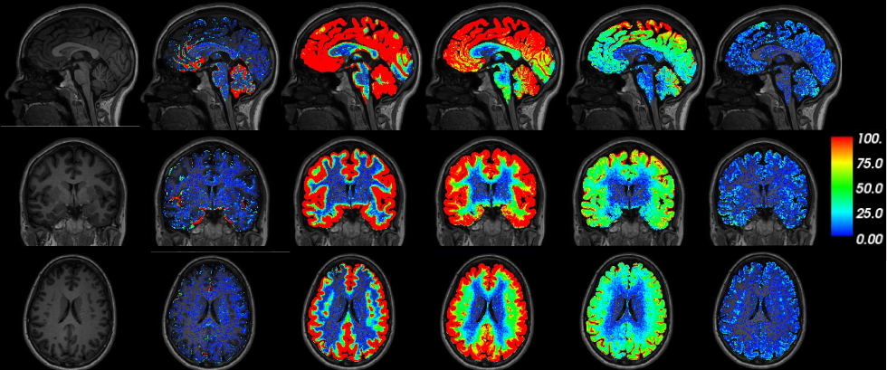
24 patients underwent gMRI to assess molecular clearance from the brain
Baseline 2 hrs 5 hrs 24 hrs 48 hrs 4 weeks

Slide 12
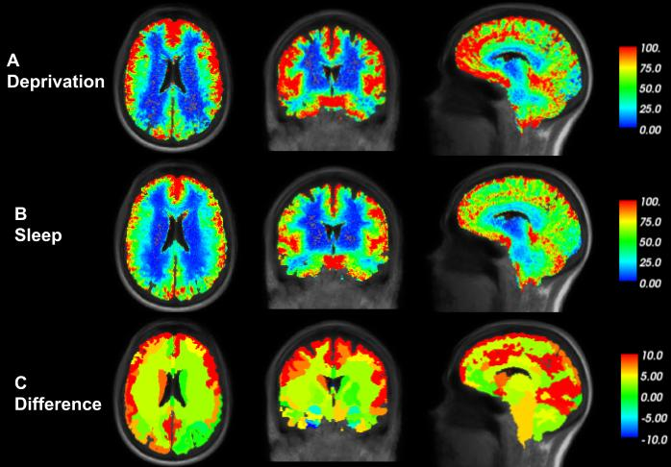
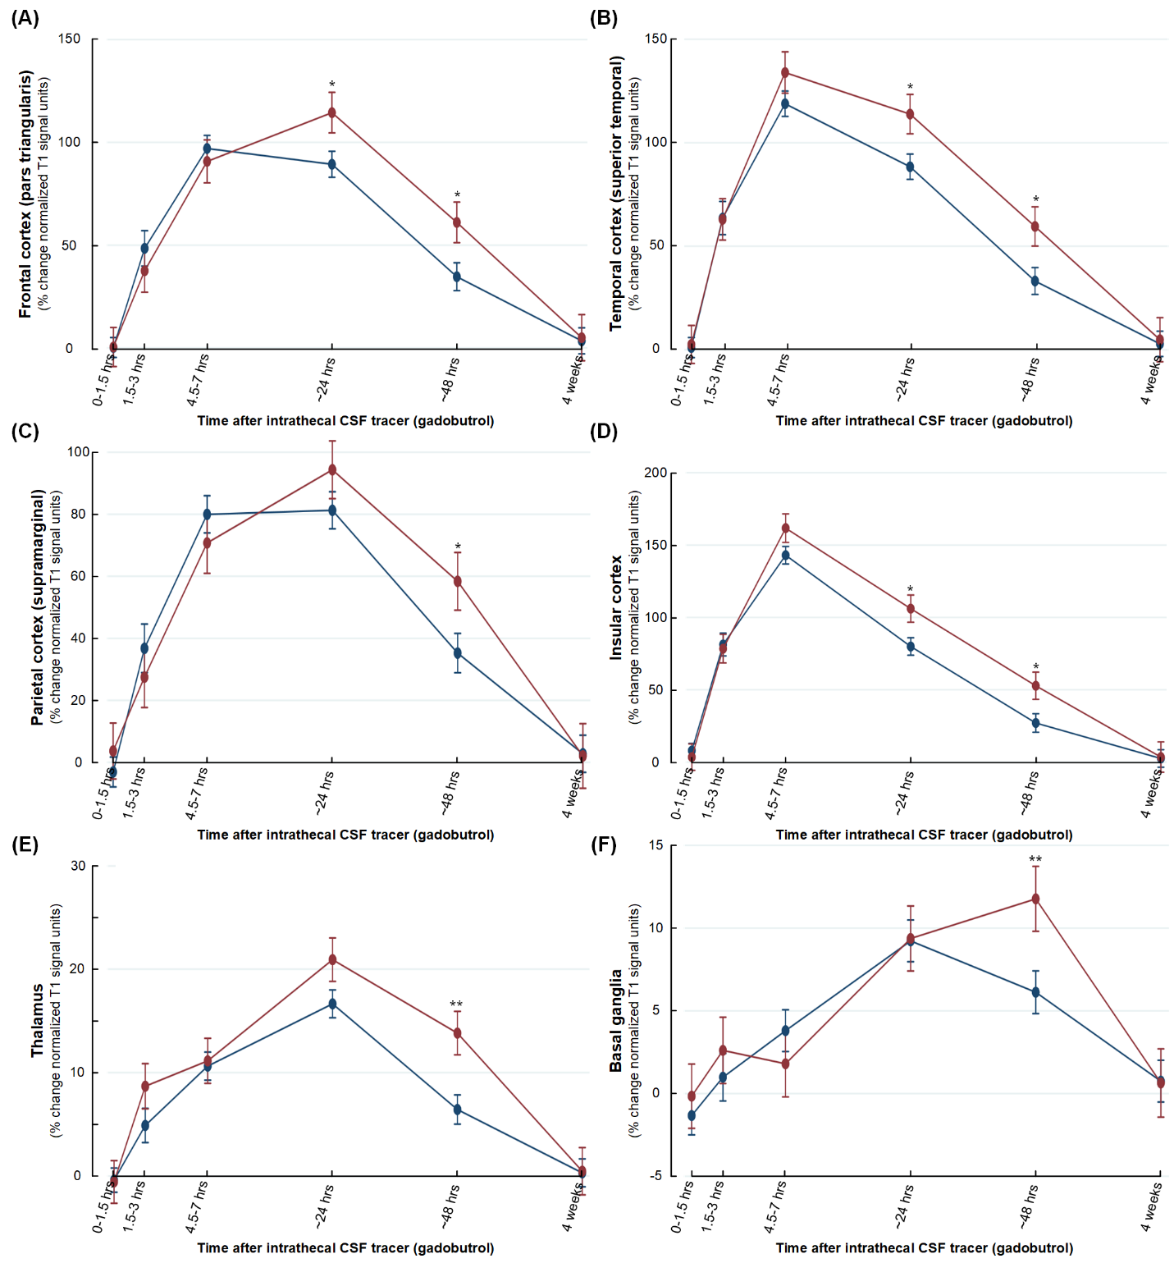

Slide 13
The first project
The brain is 1.3 dm^3
Intra-cellular 86% volume fraction (awake)
77% volume fraction (sleep)
Extra-cellular 14% volume fraction (awake)
23% volume fraction (sleep)
CSF volume 90-150 ml
CSF – extra-cellular fluid is in close contact (basically the same in equilibrium)
The volume change from awake to sleep is sudden
After the change, the CSF and extra-cellular fluid is not in equilibrium
How long does it take until equilibrium is reached? How much waste is removed from the extra-cellular space during the process?
Let us consider only diffusion

